Slide 1


ECEN 403 Final Presentation Team 48 Pocket Diagnostics Rohan Bharadwaj, Donavan Burrow, Jacob Newlin, Elijah Rodriguez Dr. Lusher

Slide 2
Problem Overview
Problem statement:
Technicians in the electronics industry have evolved to servicing customers directly for consumer products, similarly to a plumber or electrician. Often they cannot bring or access bench devices and a suitable substitute is required to complete a job in a timely manner.
Function of the Pocket Diagnostics Device:
Provide a simple, man portable bench device that can evaluate low frequency electrical signals, I2C data signals, SPI data signals, Serial data signals and 16 channel logic signals for troubleshooting on devices that contain such data transfer methods.

Slide 3
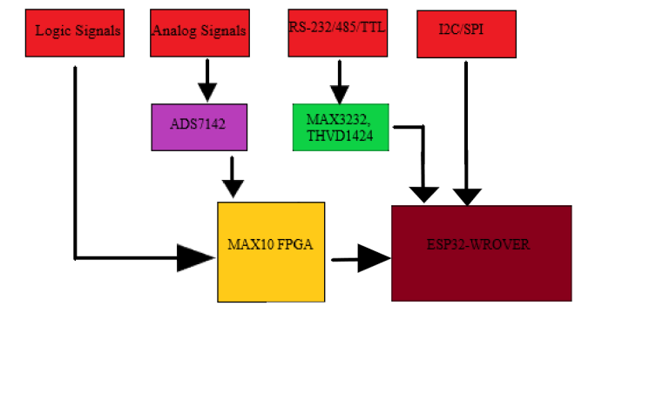
Problem Overview

Slide 4
Engineering Design Accomplishments
Firmware Development
Accomplishments: Created code to take in data from three different types of protocol. Created a connection between server and client device, then used this connection to send and receive data. Configured the design of the ESP32 pinouts in order to collect data from 5 different ports. Coded the ESP32 to take in data from 5 ports.

Slide 5
Remaining Tasks
FPGA: The FPGA used in our project still needs to be programed/flashed with the code. The plan is to have the code flashed on during 404.
ESP32: Currently the ESP32 can take in write events from the app and draw in analog signals based on the write event. The code responsible for read and indication events needs to be developed more.
ECEN 404: In 404 I plan to flash on the code for the ESP32 and FPGA on the PCB boards. The code will consist of five input tasks and then a series of conditions for write events based on what the client(app) wants. This will include responses to directives like O-scope.

Slide 6
Engineering Design Accomplishments
App Development
Accomplishments: Created a basic UI for the user to interact with, implemented a bluetooth scanner that will connect to the ESP32, and made functional UI elements that can send variable data to the ESP32 via bluetooth, all of which are functional on the phone.

Slide 7
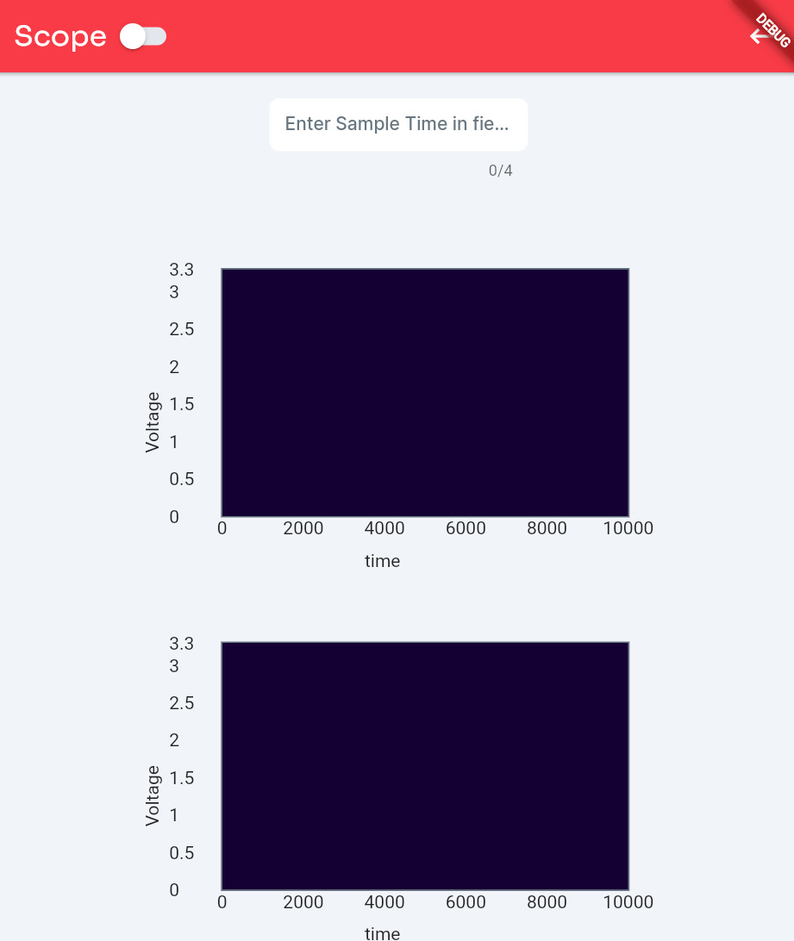
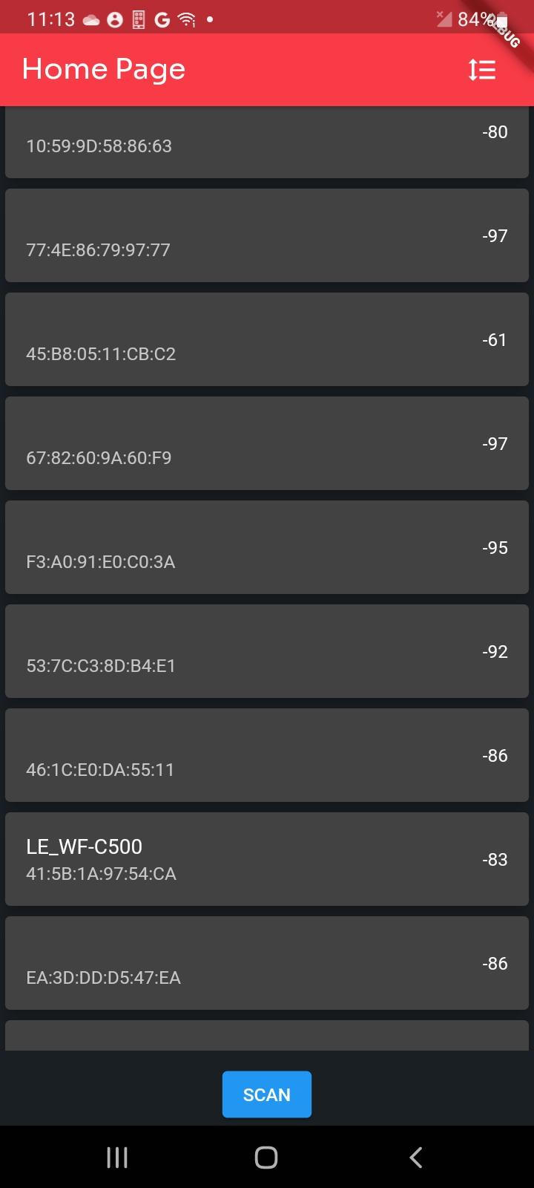
Engineering Design Accomplishments
App Development

Slide 8
Remaining Tasks
Functionality to receive data from the ESP32 is the only remaining task
Tasks for app development in 404: sending and receiving lists from the ESP32 that can be plotted or displayed on the app, for each and every function needing to be performed. Also, the UI will need to be updated so as to be functional according to the data type (for example,16 graphs for the 16 logic analyzer)

Slide 9
Engineering Design Accomplishments
Power and Data Processing
Accomplishments:
Designed the schematic for the battery monitor circuit
Completed the PCB design and implementation for the battery management, FPGA, and ADC.
Implemented analog signal input method for ADC.
Validated input voltage levels.
Component | Input Voltage Value (V)
Battery Management | 3.3 V
ADC | 3.1 V
FPGA | 3.4 V

Slide 10
Remaining Tasks
Test ADC Analog inputs
Test ADC I2C protocol outputs

Slide 11
Plans For 404
Reconfigure PCB to provide power from battery to ESP32, EEPROM, and MAX3232.
Integrate FPGA with ESP32
Implement I2C protocol for the battery management system to communicate fuel gauge levels with app.

Slide 12
Engineering Design Accomplishments
Data Communication and Collection
Designed a schematic for the serial port sniffer that includes the components MAX3232CPWR, THVD1451DR, and ESP32-WROVER-E
Completed a PCB design and implementation for the Serial Port Sniffer that includes connector ports for RS-232 and RS-485 communication protocols
Soldered the most of the necessary components to the PCB including connectors, resistors, capacitors, and communication components.

Slide 13
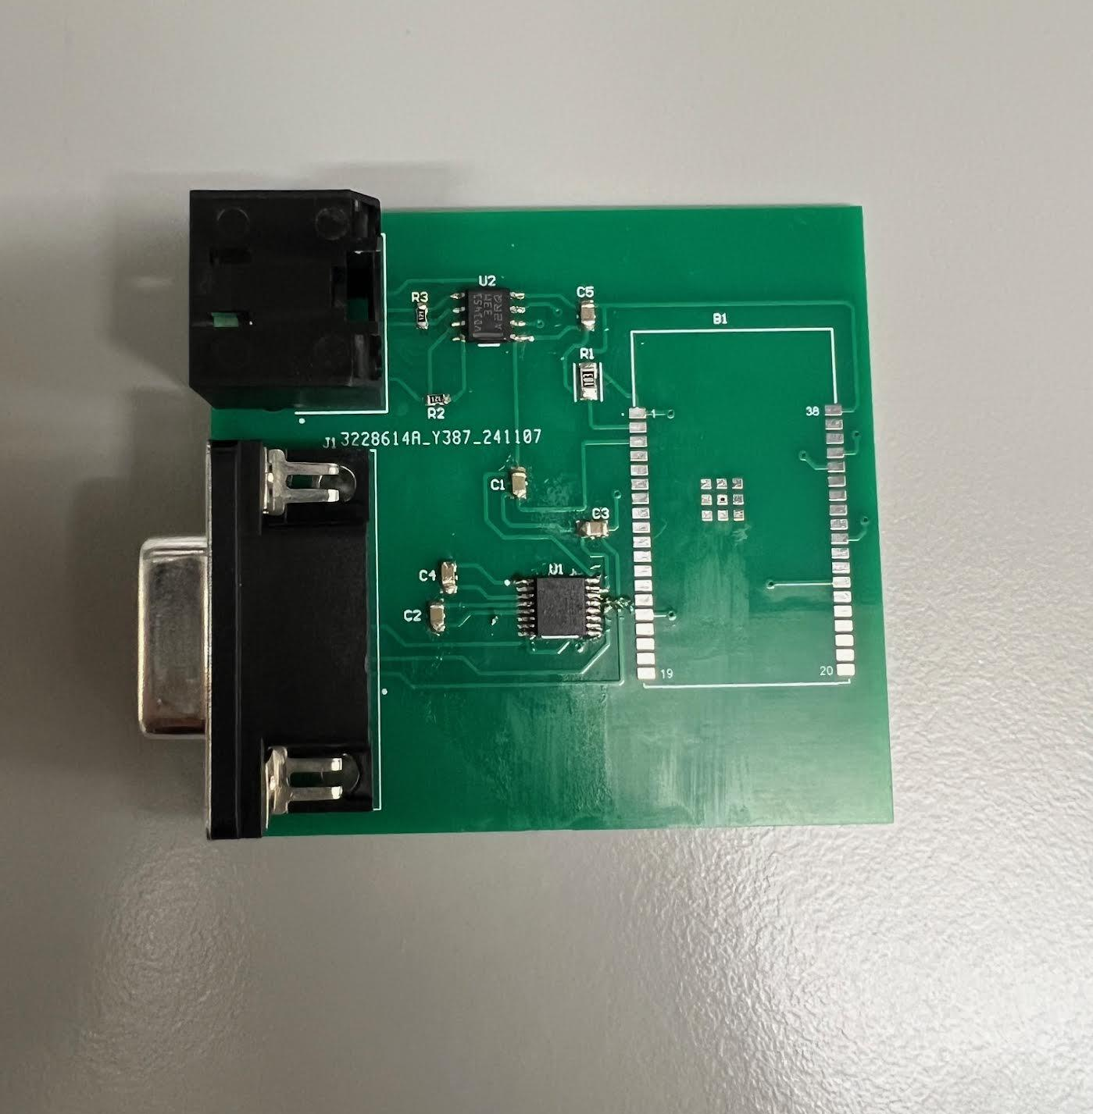
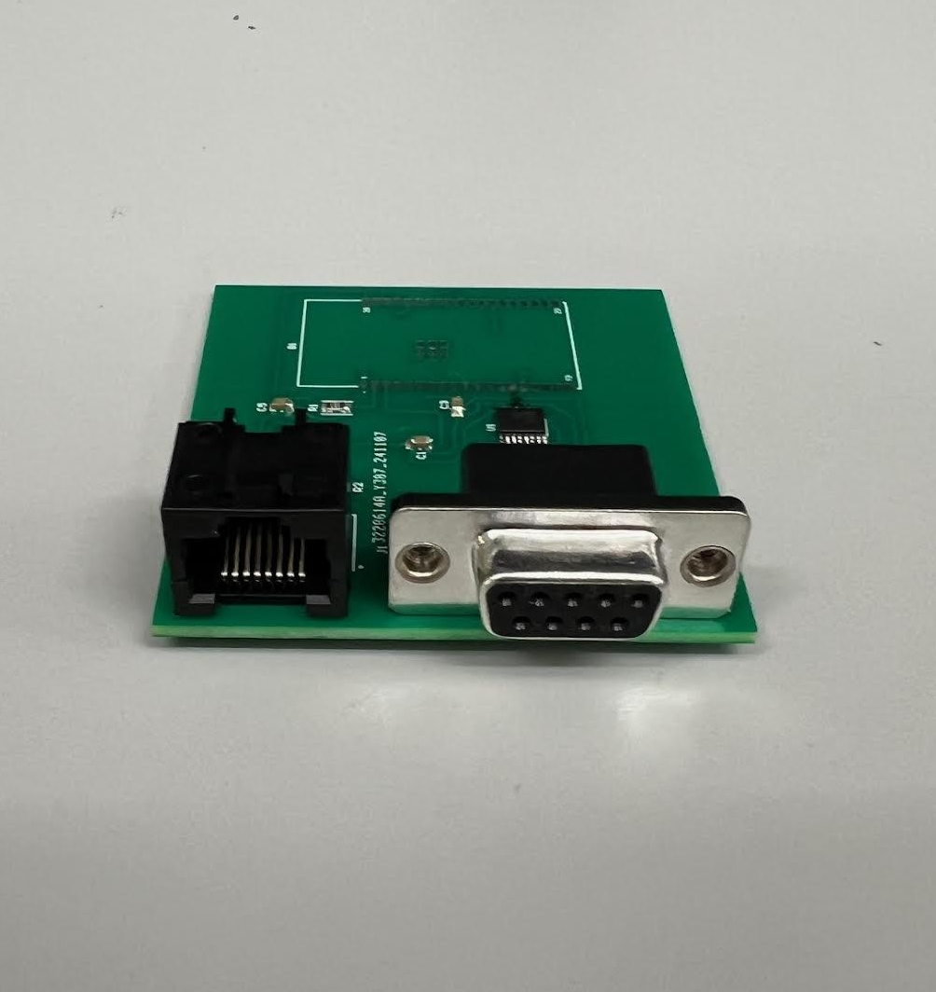

Slide 14
Remaining Tasks
Remaining Tasks:
Ensure the correct communication values for the RS-232 and RS-485 being received by the ESP32 is the same values being outputted
Speak with Jacob on configuring the ESP32 before I solder it on the PCB
Test the level shifting voltages for the MAX3232 and THVD1451
Check voltage levels at critical points on the PCB
Plans for ECEN 404:
Assembly of final PCB with all subsystems fully integrated
Work with the group to integrate a enclosure design for our project

Slide 15
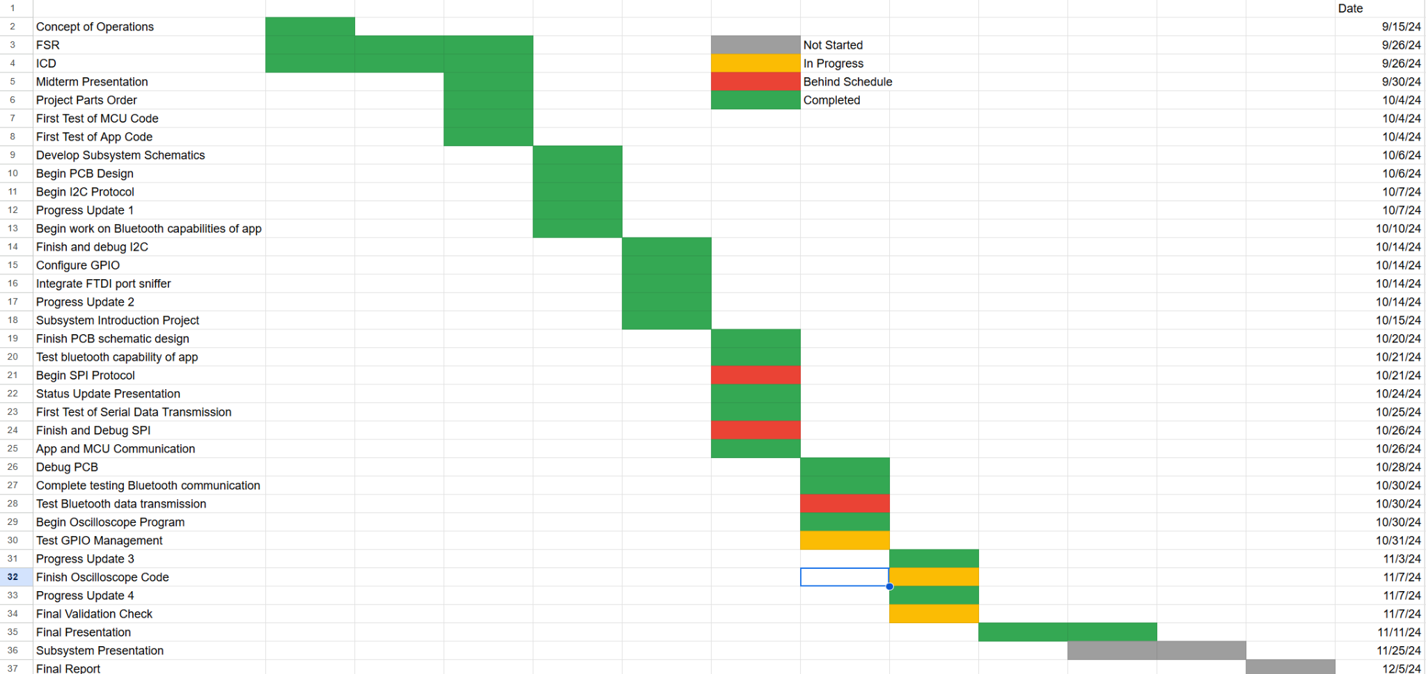
Execution Plan

Slide 16
Validation Plan
Jacob Newlin
I2C | “I2C_Task Read x bytes”
SPI | “SPI_Task Read x bytes”
UART | “UART_TASK Read x bytes”
BLUETOOTH OUT | Read EVENT
BLUETOOTH IN | Write EVENT
BLUETOOTH CONNECTION | Connection event
BLUETOOTH DISCONNECTION | Disconnection event

Slide 17
Validation Plan
Donavan Burrow
Task | Specification | Result
Bluetooth Connect | Connection Event | Pass
Bluetooth Disconnect | Disconnection Event | Pass
Bluetooth Scan | Device “GATS DEMO” Displays on list of devices | Pass
Send Data | ESP32 Displays “O, [time input by user]” on console | Pass
Receive Data | App Terminal Displays list of data coming from ESP32 | Fail

Slide 18
Validation Plan
Rohan Bharadwaj
Task | Specification | Result
Input Voltage Level | 3.3 V (+- 5%)
FPGA Input Voltage Level | 3.3 V (+- 5%)
ADC DC Input Voltage Level | 3.3 V (+- 5%)
ADC I2C Protocol | <1 MHz Clock Frequency

Slide 19
Validation Plan
Elijah Rodriguez
Task | Specification | Result
Serial Port Sniffer Verification | Verify communication values are accurately received and outputted | Not tested
Data Transmission | Data rates: <=115200 bps for RS-232 >= 10 Mbps for RS-485 | Not tested
Data Formatting | Received data matches the transmitted data with a 0% error | Not tested
MAX3232CPWR Verification | Outputs >= 3.3V | Not tested
THVD1451DR Verification | Outputs >= 3.3V | Not tested
Power Supply Validation | 3.3V supply remains stable under load | Not tested

